Slide 1


Predicting Customer Buying Behaviour
29-08-2023

Slide 2
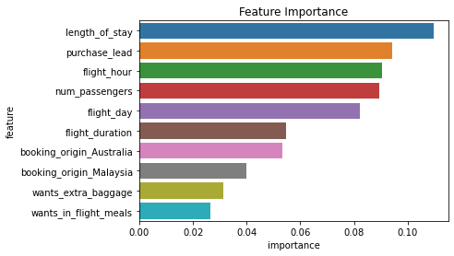
Insights
On weekends the number of passengers is less than on weekdays, but if we look at the average number of passengers, weekends have a higher value than weekdays, so it is suggested that we need see the number of flights from day to day increase at weekends.
Top flight routes must be given priorities especially at weekends.
We can see length_of_stay, purchase_lead, flight_hour, num_passengers, flight_day, flight_duration are the top features which are dependent with booking_complete feature that is to say these features could be the deciding factors for growth of customers booking our flights.
Accuracy score is 83.74 %
AUC score is 0.5914
Feature Importance with respect to booking_complete
which indicates if the customer completed the booking

